Slide 1
QUEUE
Education is the best friend. An educated person is respected everywhere. Education beats the beauty and the youth.
Chanakya

Slide 2
Queue
A queue is an ordered list in which all insertions take place at one end and all deletions take place at the opposite end. It is also known as First-In-First-Out (FIFO) lists.
a₀
a₁
a₂
a_{n-1}
front
rear

Slide 3
Queue: a First-In-First-Out (FIFO) list
A
B
A
C
B
A
D
C
B
A
rear
front
D
C
B
rear
front
rear
front
rear
front
Rear
front
Rear
front
*Figure : Inserting and deleting elements in a queue

Slide 4
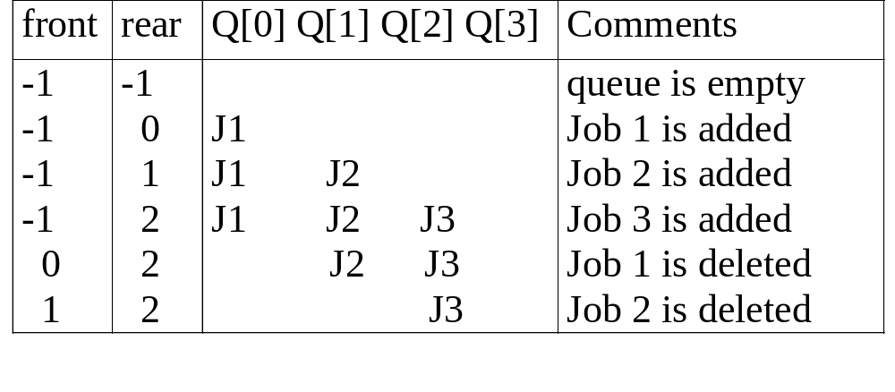
Application: Job scheduling
*Figure 3.5: Insertion and deletion from a sequential queue

Slide 5
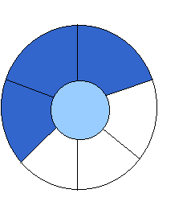
Implementation 2: regard an array as a circular queue
front: one position counterclockwise from the first element
rear: current end
EMPTY QUEUE
[3] [2] [3]
[2]
J2
J3
[1] [4] [1] [4]
J1
[0] [5] [0] [5]
front = 0 front = 0
rear = 0 rear = 3
*Figure: Empty and nonempty circular queues

Slide 6

Problem: one space is left when queue is full
FULL QUEUE FULL QUEUE
[2] [3] [2] [3]
J2 J3
J8 J9
J7
[1] [4][1] [4]
J1 J4
J5
J6 J5
[0] [5] [0] [5]
front =0
rear = 5
front =4
rear =3
*Figure: Full circular queues and then we remove the item

Slide 7
void addq(element item)
{
/* add an item to the queue */ int k = (rear +1) % MAX_QUEUE_SIZE; if (front == k) /* reset rear and print error */ return; rear = k; queue[rear] = item;
}
*Program: Add to a circular queue
Add to a circular queue
[2] [3]
J2
J3
[1] [4]
J1
[0] [5]
front = 0
rear = 3

Slide 8
element deleteq()
{ element item;
/* remove front element from the queue and put it in item */ if (front == rear) return queue_empty( );
/* queue_empty returns an error key */ front = (front+1) % MAX_QUEUE_SIZE; return queue[front];
}
*Program 3.6: Delete from a circular queue
Delete from a circular queue
[2] [3]
J2
J3
[1] [4]
J1
[0] [5]
front = 0
rear = 3
CHAPTER 3

Slide 9
Circular Queue
To resolve the issue of moving elements in the queue, circular queue assigns next element to q[0] when rear == MaxSize – 1.
Pointer front will always point one position counterclockwise from the first element in the queue.
Queue is empty when front == rear. But it is also true when queue is full. This will be a problem.

Slide 10
Circular Queue (Cont.)
4
J4
4
J3
n-4
n-4
3
3
J2
J1
n-3
J2
n-3
2
J1
2
J3
n-2
J4
n-2
1
1
0
n-1
0
n-1
front = 0; rear = 4
front = n-4; rear = 0

Slide 11
Circular Queue (Cont.)
To resolve the issue when front == rear on whether the queue is full or empty, one way is to use only MaxSize – 1 elements in the queue at any time.
Each time when adding an item to the queue, newrear is calculated before adding the item. If newrear == front, then the queue is full.
Another way to resolve the issue is using a flag to keep track of last operation. The drawback of the method is it tends to slow down Add and Delete function.

